Slide 1

Driving health and competitiveness forward
Swedish-Danish conference on Nordic leadership in life science
Sep 22, 2025, 2:30 PM - Sep 22, 2025, 7:00 PM
Kantinen, Forskaren, Hagaesplanaden 49, Stockholm

Slide 2

About the event
Keynote by MEP Stine Bosse, the Vice-Chair of the European Parliament's Committee on Public Health for Renew Europe. As a Danish MEP representing Moderaterne, she is also the highest-ranking Nordic member of the public health committee. MEP Bosse is also the founder and co-chair of the EU Biotech and Life Sciences Alliance, an MEP interest group founded to gather members of the European Parliament interested in biotechnology across sectors.
In an era of intensifying global competition and shifting research investments, it is vital to identify the domains where Europe can lead. There is growing recognition within the European Commission that the life science sector is critical to Europe's long-term competitiveness.
Now is the time to align around a shared vision and take collective action toward a healthier, more competitive, and globally leading Europe - with life science at its core.
This Swedish-Danish conference will highlight the strengths and challenges facing our region, explore how best to realize our shared ambitions and the potential to take the lead within the European transformation. The program features keynote speakers, government leaders, EU officials, industry representatives, and SMEs – all engaging in dialogue on the future of life science in Europe.
22 SEPTEMBER, STOCKHOLM
  2:30 PM
  Kantinen, Forskaren, Hagaesplanaden 49, Stockholm
  Language: English
  In-person and invite-only event (no online participation)
2

Slide 3
Gunilla Osswald, CEO, BioArctic
Agenda
14:30 Welcome and Opening Keynote
Welcome by Monica Åberg Yngwe EIT Health Scandinavia
Jens Kisling, Ambassador, Embassy of Denmark, Sweden
(Welcome remarks )
14:40 Stine Bosse, Vice Chair of the European Parliament Committee on Public Health Keynote address on how EU biotech and life sciences can deliver for patients and competitiveness in a changing world
15:20 Sara Modig, State Secretary Ministry of Climate and Enterprise
15:30 Aida Hadzialic, Mayor of Metropolitan Stockholm
15:40 Jeanette Edblad (Sweden), Director of the Office for Life Sciences, Government Offices
Katrina Feilberg Schouenborg, Director for Health & Life Science,
The Danish Chamber of Commerce (Denmark)
Moderator: Jenni Nordborg, Director of International Affairs, Lif
16:00 Break
16:20 Panel Discussions – Perspectives from Industry and SMEs
  Anette Steenberg, CEO of Medicon Valley Alliance
  Emeli Antoni, Country President Nordic, Astra Zeneca
  Johan Höglund, CEO Sweden, Coloplast
  Morten Henneveld, CEO, OssDsign
  Andreas Muranyi Scheutz, Director Research and Innovation, Region Stockholm
  Gunilla Osswald, CEO, BioArctic
17:10 Concluding remarks: Moving forward together
  Sofia Wallström, CEO, Lif
  Anna Lefevre Skjöldebrand, CEO, Swedish Medtech
17:30 - 19:00 Mingle
*Please note that this is the current status of the speaker lineup, and additional speakers will be added. For the latest updates, please check the event website.
3

Slide 4
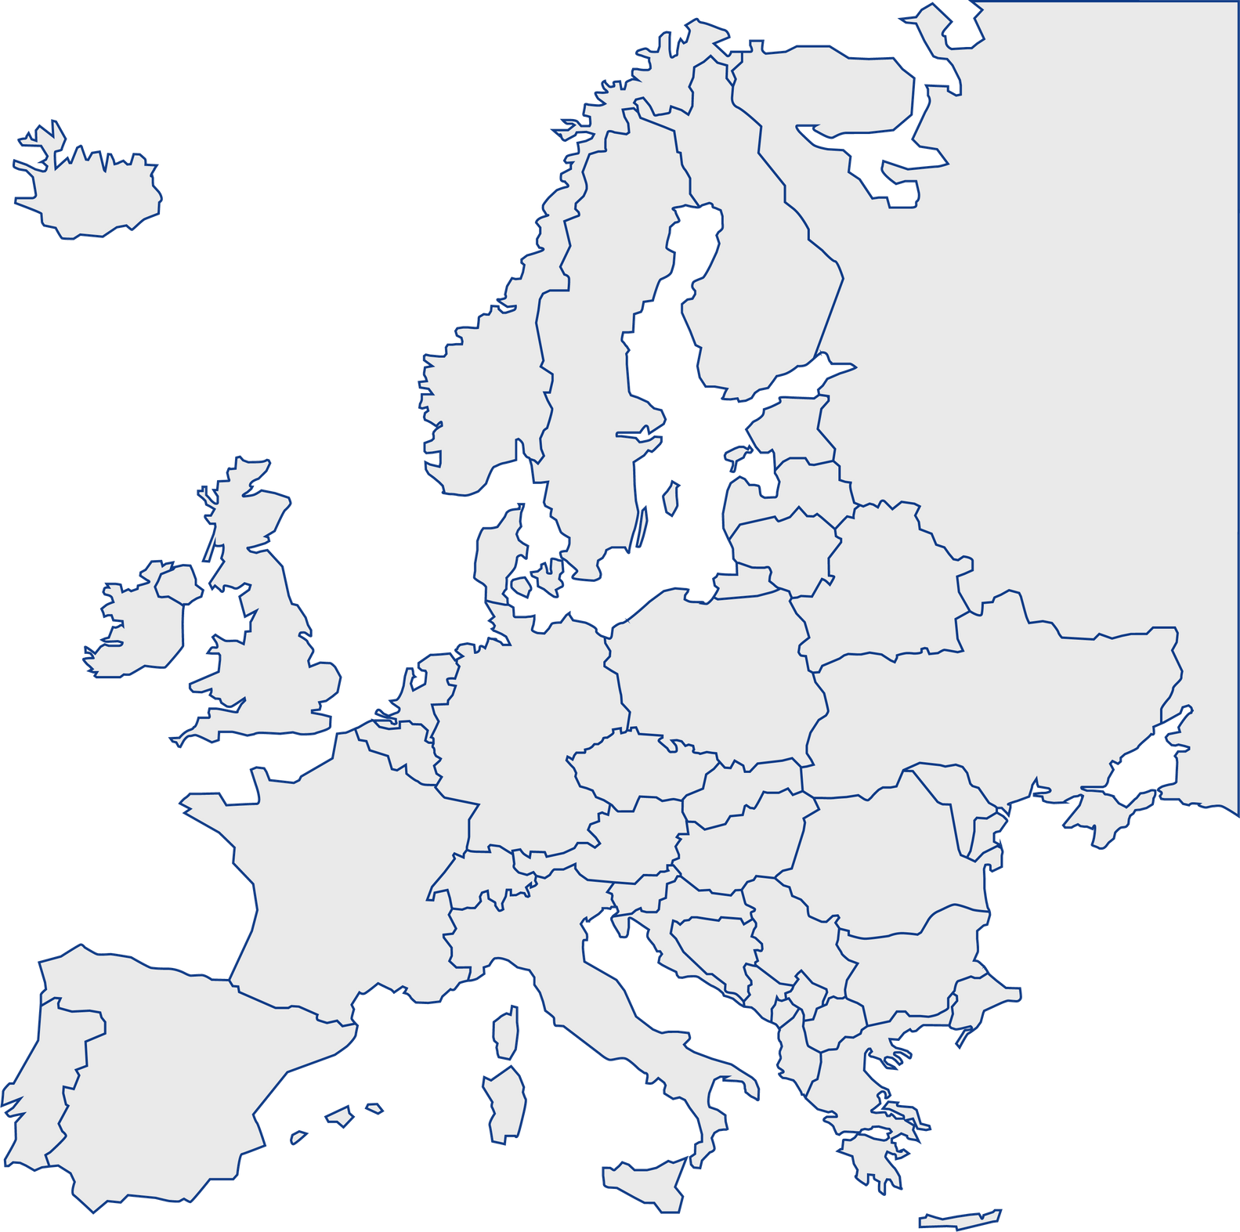






Contact:
Monica Åberg Yngwe
Monica.Yngwe@eithealth.eu
Co-Organisers:
7
4

